Slide 1
Significant Features Analysis for Android Malware Detection using Machine Learning Techniques
Submitted by
Asadullah Hill Galib
Exam Roll: 702 (MSSE)
Institute of Information Technology
University of Dhaka
Supervised by
Dr. B. M. Mainul Hossain
Associate Professor
Institute of Information Technology
University of Dhaka

Slide 2
Outline
Introduction
Related Works
Significant Features Analysis Approach
Evaluation
Limitation
Conclusion
Future Works
Publications

Slide 3
Introduction
Android malware detection techniques
Static Analysis
Dynamic Analysis
Hybrid Analysis
Using full features set

Slide 4
Introduction
The number of features is growing exceedingly
Large features set make it complex and may overfit the model
Analyzing significant features to reduce complexity and accelerate large scale detection

Slide 5
Introduction
Significant Permissions Analysis
Significant API Calls Analysis
Significant Ensemble Features Analysis

Slide 6
Research Question
RQ: How can we detect Android malware using significant features based on machine learning techniques?
SQ1: How can we select the significant features for Android malware detection using machine learning?
SQ2: How do the significant features perform in Android malware detection?

Slide 7
Related Works
Significant Ensemble Features Based Approaches
Significant API Calls Based Approaches
Significant Permissions Based Approaches
Static Analysis Based Approaches
Dynamic Analysis Based Approaches
Hybrid Analysis Based Approaches

Slide 8
Significant Ensemble Features Based Approaches
Aswini et al. [2014]
Permission and API Calls
5 feature selection techniques
168 ensemble features
93.02% accuracy (random forest)

Slide 9
Significant Ensemble Features Based Approaches
Fest [2015]
Permission, API Calls, Actions, IP and URL
Proposed feature selection technique
398 ensemble features
97.5% accuracy, 97.5 recall, 3.2% FPR, and97.5% TPR

Slide 10
Significant API Calls Based Approaches
DroidAPIMiner [2013]
Critical API Calls using frequency analysis
169 API Calls
99% accuracy, 97.8% TPR

Slide 11
Significant API Calls Based Approaches
Zhao et al. [2018]
20 sensitive API Calls using mutual information gain
Ensemble learning model: KNN and decision tree
92% accuracy, 93% precision, and 89% TPR

Slide 12
Significant API Calls Based Approaches
Alazab et al. [2020]
Grouping of API Calls using frequency
1326 API Calls
94.3% F-measure

Slide 13
Significant Permissions Based Approaches
SigPID [2016]
3-level data pruning approach
22 Permissions from 135 Permissions
95.63% accuracy, 97.54% precision, 93.62% recall, 2.36% FPR, and 95.54% F-measure

Slide 14
Significant Permissions Based Approaches
Altaher et al.[2017]
Adaptive neuro-fuzzy inference system (ANFIS) with fuzzy c-means clustering (Mutual Information)
24 Permissions
91% accuracy, 0.5% FPR, and 0.4% FNR

Slide 15
Significant Permissions Based Approaches
Wang et al.[2014]
Mutual Information, Correlation coefficient, and T-test
Sequential Forward Selection and PCA
40 Permissions
92.79% accuracy, 94.62% TPR, and 0.6% FPR

Slide 16
Significant Features Analysis Approach
Significant Permissions Analysis
Significant API Calls Analysis
Significant Ensemble Features Analysis

Slide 17
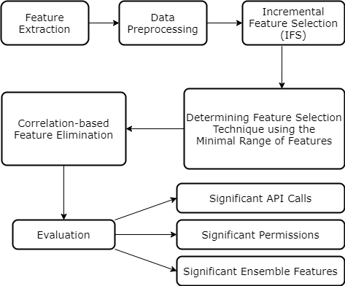
Significant Features Analysis Approach

Slide 18
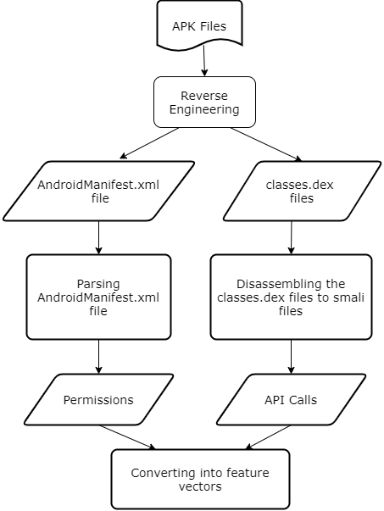
Feature Extraction

Slide 19
Data Preprocessing
Label Encoding
Dataset split
half for feature selection
half for evaluation
10-fold cross validation

Slide 20
Incremental Feature Selection (IFS)
Firstly, how many numbers of features should be selected as significant features?
From one to the highest number of features are assessed
The minimal number of features is evaluated by analyzing performance metrics (5)

Slide 21
Incremental Feature Selection (IFS)
Secondly, which feature selection technique is better suited to reduce the number of features while preserving performances?
Feature Selection Techniques analyzed (7):
Mutual Information Gain (Entropy Based)
Univariate ROC-AUC Score
SelectKBest with chi-squared distribution

Slide 22
Incremental Feature Selection (IFS)
Feature Selection Techniques analyzed:
SelectFromModel (Tree-Based)
Classifier: Random Forest and Extra Trees
Recursive Feature Elimination (RFE)
Classifier: Random Forest and Gradient Boosting

Slide 23
Determining Feature Selection Technique using the Minimal Range of Features
Analysis of performance metrics to identify the minimal range of features for each techniques
Selection of feature selection technique which gives the lowest minimal range

Slide 24
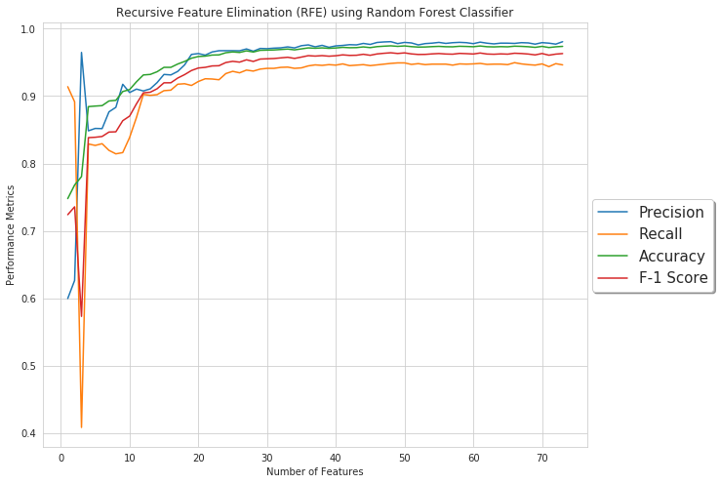
Minimal Range of Features

Slide 25
Correlation-based Feature Elimination
Pearson correlation-based feature elimination strategy
If two features are highly correlated, then removing one of them would not affect the classification
The less important feature from each pair is removed

Slide 26
Malware Classification
Random Forest
10-fold
For all the features set of minimal range of features

Slide 27
Evaluation (Dataset)
Drebin
5560 malware samples, 9470 benign samples
73 API Calls
Android Malware Genome Project
1200 malware samples, 2539 benign samples
69 API Calls

Slide 28
Evaluation (Significant API Calls)
Identifying Feature Selection Technique using Minimal Range of Features
Correlation-based Feature Elimination
Evaluate performance with significant API Calls

Slide 29
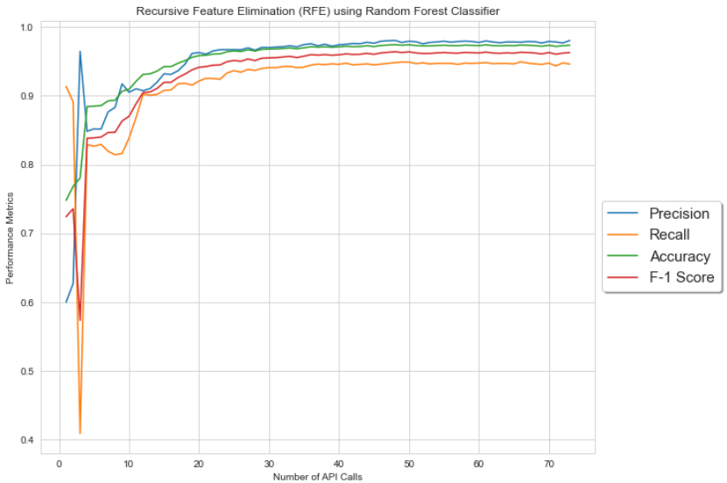
Minimal Range of API Calls for RFE with Random Forest (Drebin)

Slide 30
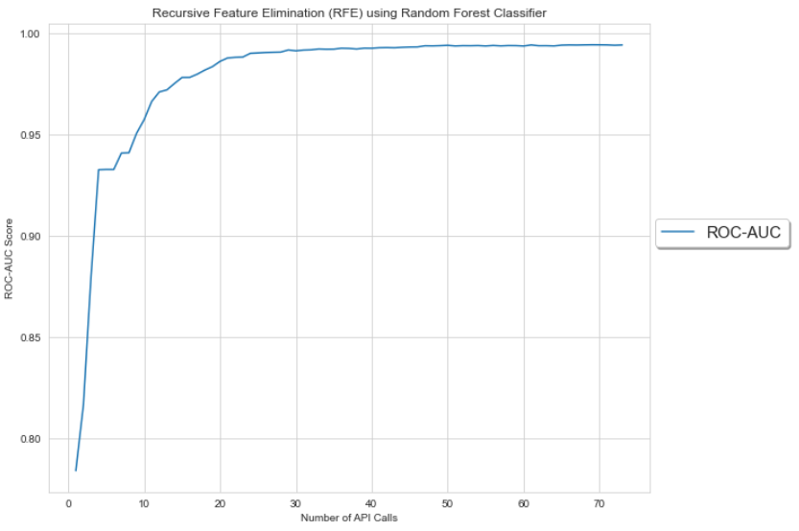
Minimal Range of API Calls for RFE with Random Forest (Drebin)

Slide 31
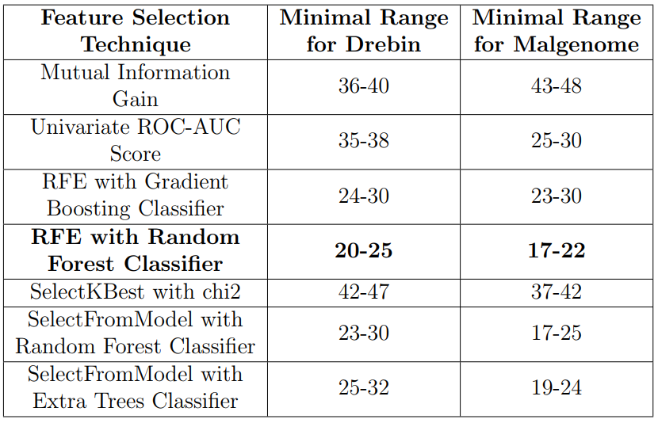
Minimal Range of API Calls for Different Feature Selection Techniques

Slide 32
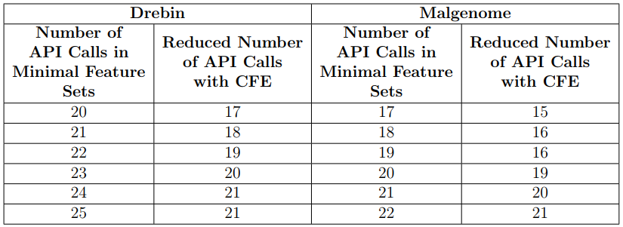
Correlation-based Feature Elimination on the Minimal Features Sets

Slide 33
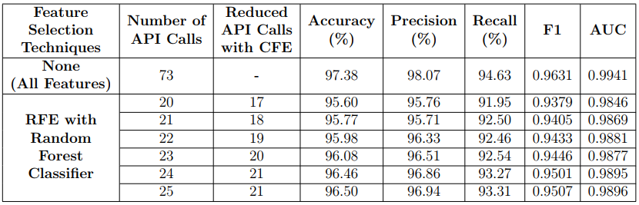
Performance Evaluation of Significant API Calls (Drebin)

Slide 34
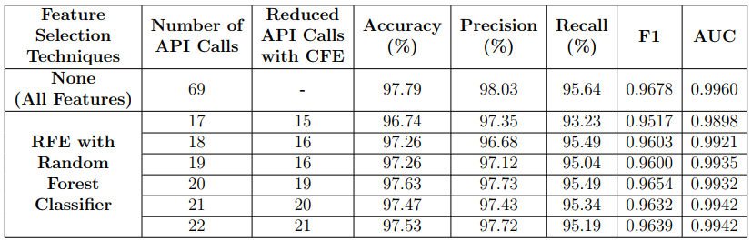
Performance Evaluation of Significant API Calls (Malgenome)

Slide 35
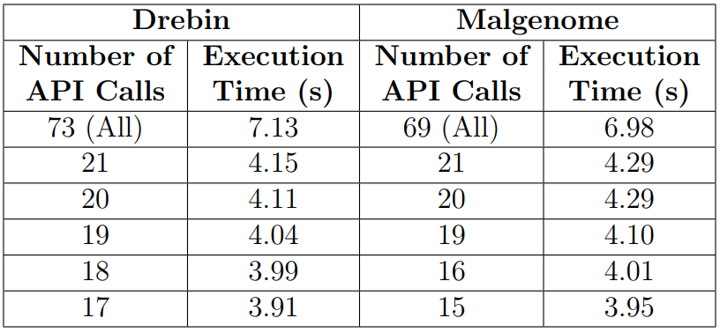
Execution Time of Significant API Calls

Slide 36
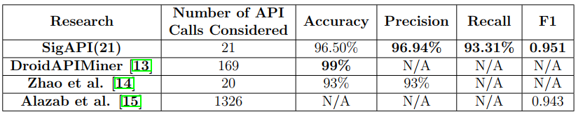
Comparison with Related Works (Significant API Calls)

Slide 37
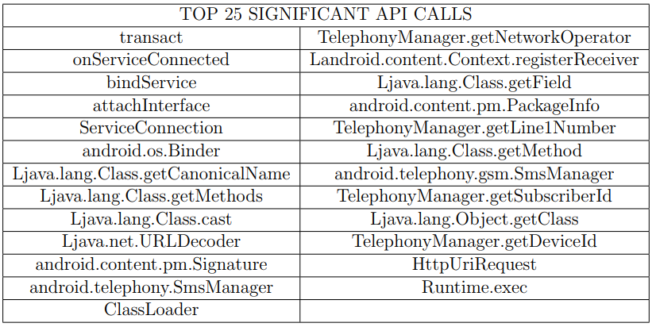
Top 25 Significant API Calls

Slide 38
Evaluation (Significant Permissions)
Identifying Feature Selection Technique using Minimal Range of Features
Correlation-based Feature Elimination
Evaluate performance with significant Permissions

Slide 39
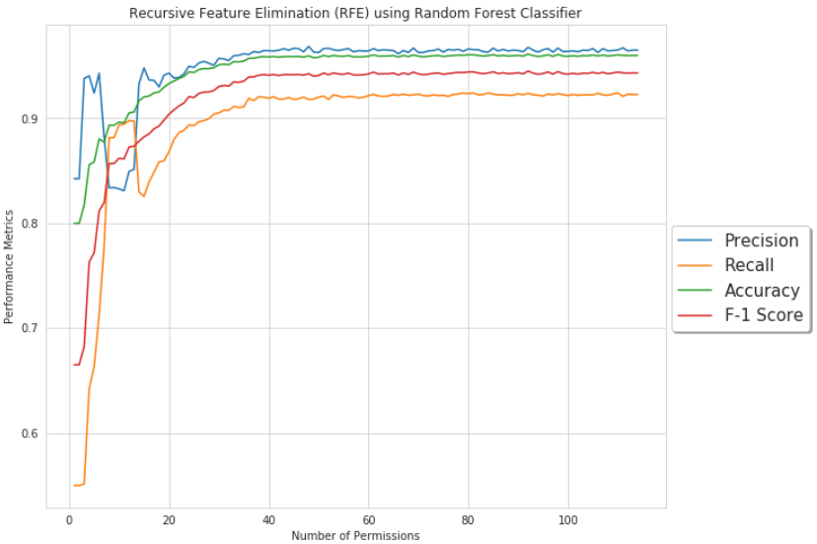
Minimal Range of Permissions for RFE with Random Forest (Drebin)

Slide 40

Minimal Range of Permissions for RFE with Random Forest (Drebin)

Slide 41
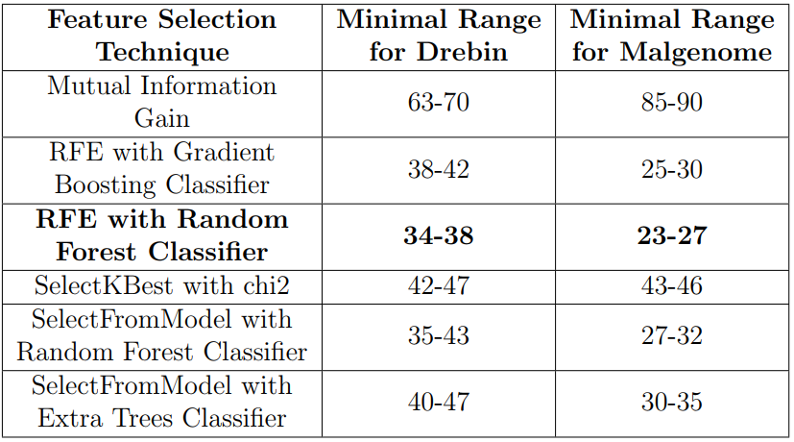
Minimal Range of Permissions for Different Feature Selection Techniques

Slide 42
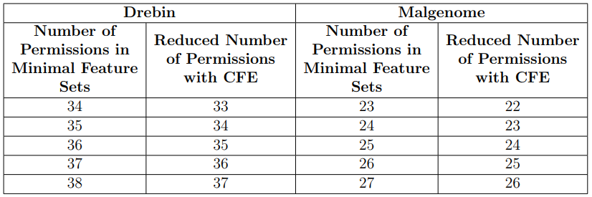
Correlation-based Feature Elimination on the Minimal Features Sets

Slide 43
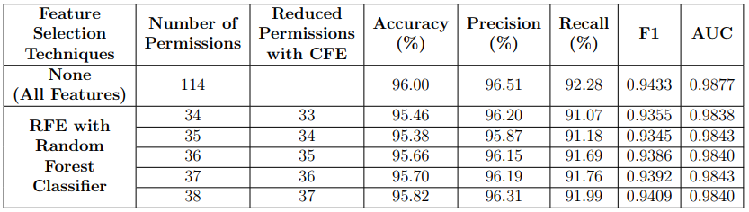
Performance Evaluation of Significant Permissions (Drebin)

Slide 44
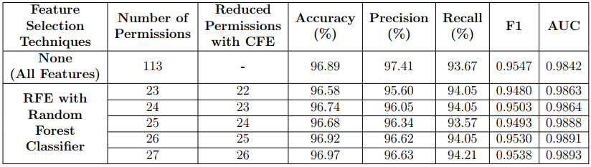
Performance Evaluation of Significant Permissions (Malgenome)

Slide 45
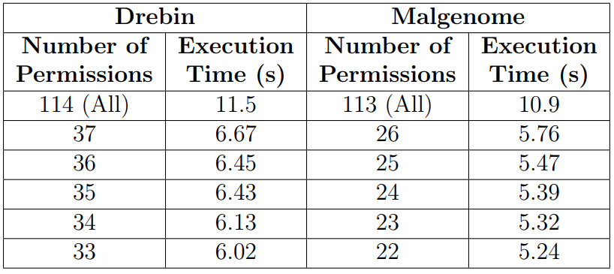
Execution Time of Significant Permissions

Slide 46
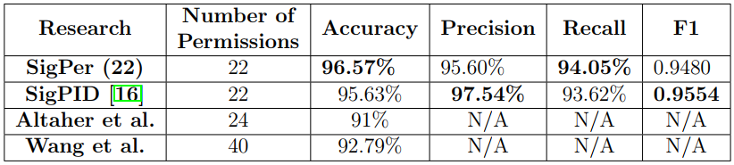
Comparison with Related Works (Significant Permissions)

Slide 47
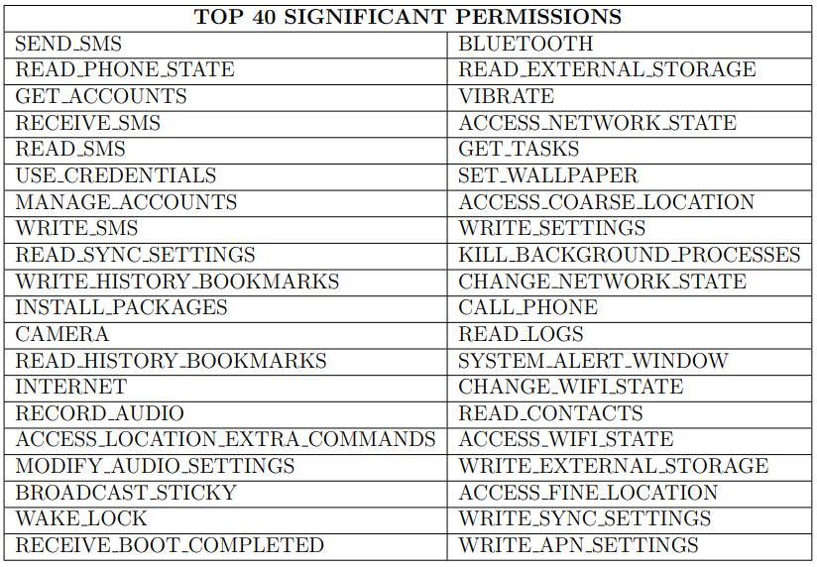
Top 40 Significant Permissions

Slide 48
Evaluation (Significant Ensemble Features)
Identifying Feature Selection Technique using Minimal Range of Features
Correlation-based Feature Elimination
Evaluate performance with significant ensemble features

Slide 49
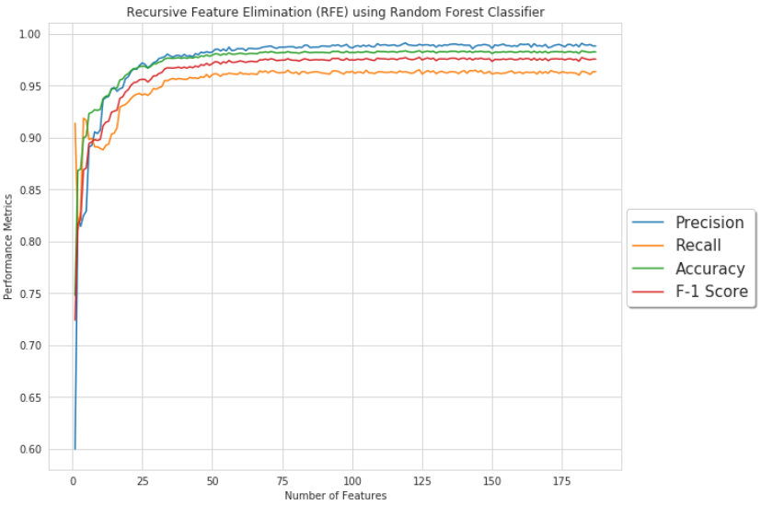
Minimal Range of ensemble features for RFE with Random Forest (Drebin)

Slide 50
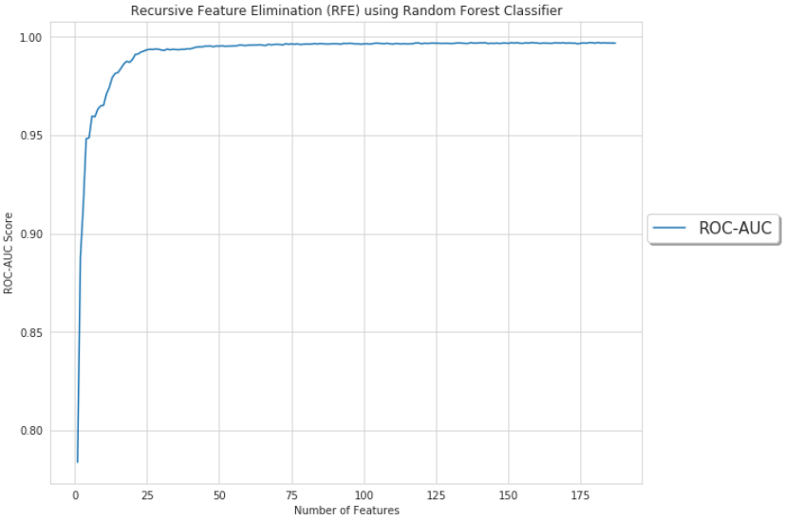
Minimal Range of ensemble features for RFE with Random Forest (Drebin)

Slide 51
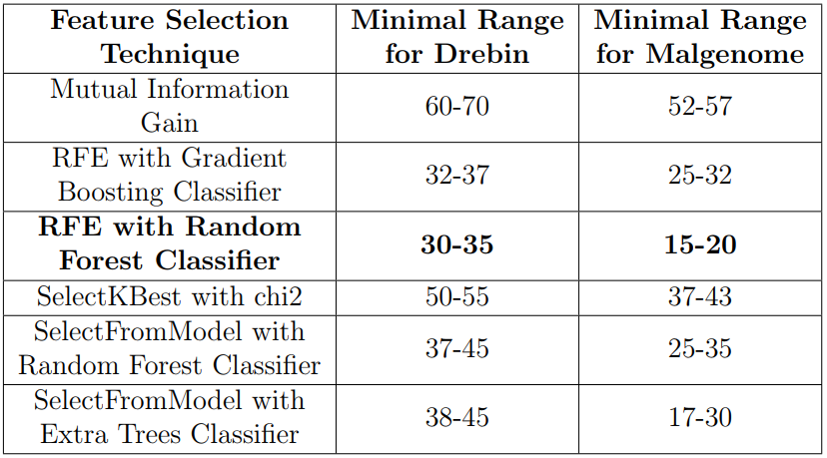
Minimal Range of ensemble features for Different Feature Selection Techniques

Slide 52
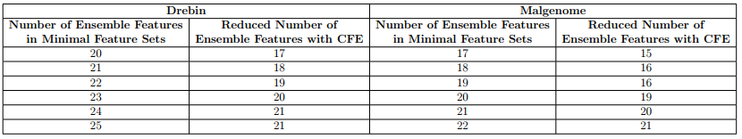
Correlation- based Feature Elimination on the Minimal Features Sets

Slide 53
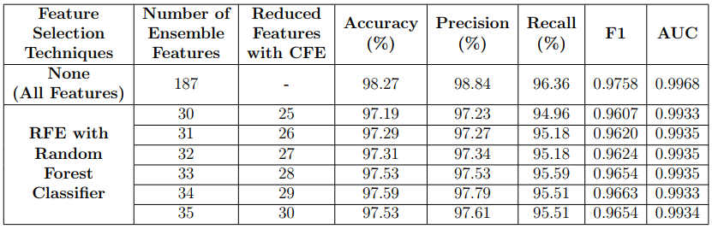
Performance Evaluation of Significant ensemble features
(Drebin)

Slide 54

Performance Evaluation of Significant ensemble features (Malgenome)

Slide 55
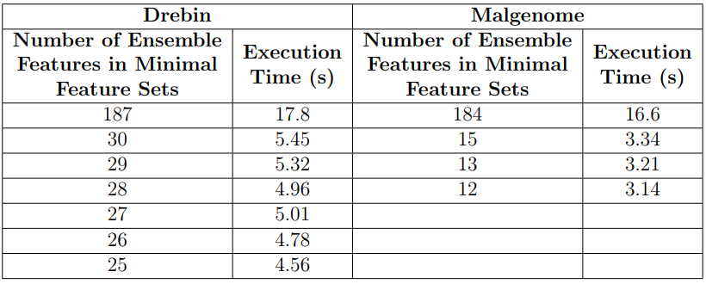
Execution Time of Significant ensemble features

Slide 56
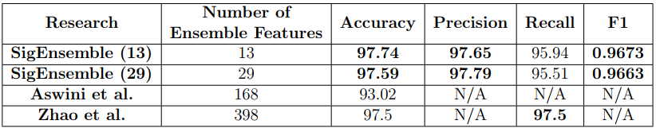
Comparison with Related Works (Significant ensemble features)

Slide 57
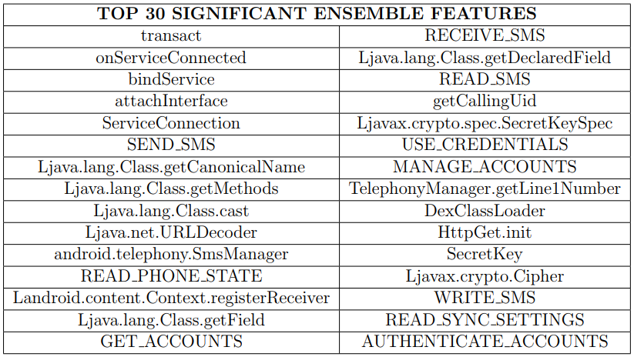
Top 30 Significant ensemble features

Slide 58
Limitation
Threats to Internal Validity
The parameters of different techniques and algorithms are susceptible to bias
Threats to External Validity
The datasets are subject to bias and induce lack of generalizability

Slide 59
Conclusion
RFE with Random Forest Classifier provides the minimal range of significant features
Significant ensemble features outperform individual types of features, like Permissions and API Calls.
The experiments have been replicated with 2 datasets

Slide 60
Conclusion
73 to 20 API Calls, 114 to 33 permissions, and 187 ensemble features to 25 features without affecting the performance notably
Identifying significant features would be convenient considering performance and computational complexity

Slide 61
Future Works
Reevaluating using different and large datasets
Employing Deep learning, reinforcement learning, and ensemble learning
Incorporating features like system call, network activities, etc.

Slide 62
Publications
Galib, A.H., Hossain, B. M. (2020, July). Significant API Calls in Android Malware Detection (Using Feature Selection Techniques and Correlation Based Feature Elimination). In Proceedings of the 32nd International Conference on Software Engineering Knowledge Engineering (pp. 566-571).
Galib, A.H., Hossain, B. M. (2019, December). A Systematic Review on Hybrid Analysis using Machine Learning for Android Malware Detection. International Conference on Innovation in Engineering and Technology (ICIET) 2019.
Galib, A. H., Hossain, B. M. (2020). A Review on Hybrid Analysis using Machine Learning for Android Malware Detection. Dhaka University Journal of Applied Science Engineering (DUJASE), Volume 5(1 & 2). Manuscript in press.

Slide 63
References
1. D. Arp, M. Spreitzenbarth, M. Hübner, H. Gascon, and K. Rieck, “Drebin: Effective and Explainable Detection of Android Malware in Your Pocket,” Proceedings 2014 Network and Distributed System Security Symposium, 2014.
2. Yajin Zhou, Xuxian Jiang, "Dissecting Android Malware: Characterization and Evolution," Proceedings of the 33rd IEEE Symposium on Security and Privacy (Oakland 2012), San Francisco, CA, May 2012
3. Yerima, S. Y., Sezer, S., McWilliams, G., & Muttik, I. (2013, March). A new android malware detection approach using Bayesian classification. In 2013 IEEE 27th international conference on advanced information networking and applications (AINA) (pp. 121-128). IEEE.
4. Peiravian, N., & Zhu, X. (2013, November). Machine learning for android malware detection using permission and api calls. In 2013 IEEE 25th international conference on tools with artificial intelligence (pp. 300-305). IEEE.
5. Yerima, S. Y., Sezer, S., & Muttik, I. (2014, September). Android malware detection using parallel machine learning classifiers. In 2014 Eighth International Conference on Next Generation Mobile Apps, Services and Technologies (pp. 37-42). IEEE.

Slide 64
References
6. Aafer, Y., Du, W., & Yin, H. (2013, September). Droidapiminer: Mining api-level features for robust malware detection in android. In International conference on security and privacy in communication systems (pp. 86-103). Springer, Cham.
7. Li, J., Sun, L., Yan, Q., Li, Z., Srisa-an, W., & Ye, H. (2018). Significant permission identification for machine-learning-based android malware detection. IEEE Transactions on Industrial Informatics, 14(7), 3216-3225.
8. Altaher, A., & BaRukab, O. (2017). Android malware classification based on ANFIS with fuzzy c-means clustering using significant application permissions. Turkish Journal of Electrical Engineering & Computer Sciences, 25(3), 2232-2242.
9. Wang, W., Wang, X., Feng, D., Liu, J., Han, Z., & Zhang, X. (2014). Exploring permission-induced risk in android applications for malicious application detection. IEEE Transactions on Information Forensics and Security, 9(11), 1869-1882

Slide 65
Thank you!
Any questions?

